Slide 1
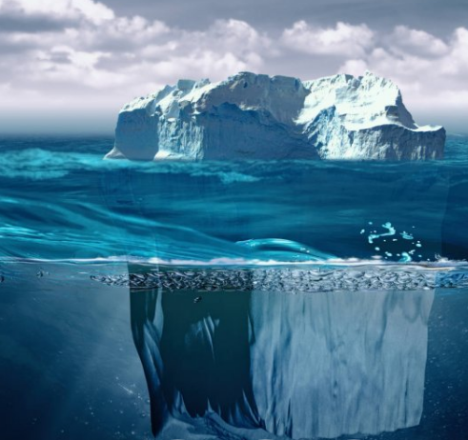
IceBerg Detection in Satellite Images using IBM Watson Studio
BATCH CSE-B-OO2
TEAM :
P .HEMA
V. VAMSHI
K.MEGHANA
M.AJAY

Slide 2
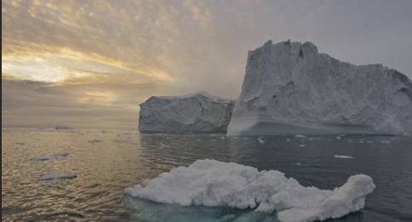

INTRODUCTION
Icebergs present serious hazards for ship navigation and offshore installations. Iceberg roots a dangerous risk for transportation, marine oil and gas production plants.
Data on Iceberg and Island is significant for atmosphere science and for different marine activities in the sea.
The main objective of our study is to estimate the possibility of using different satellite images for iceberg detection among open water, fast ice and drifting ice.

Slide 3
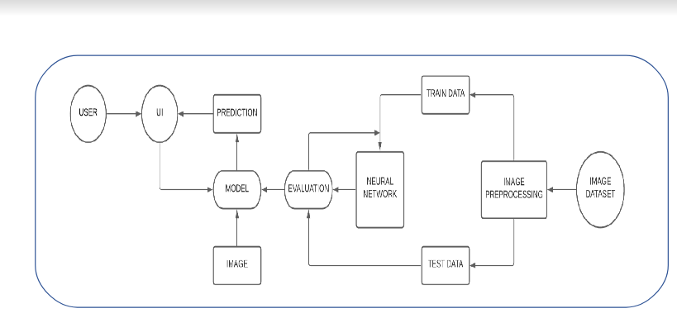
BLOCK DIAGRAM

Slide 4
FLOW -CHART
DATA
IMAGE
MODEL BUILDING
TEST THE MODEL ON IBM
APPLICATION BUILDING
TRAIN THE MODEL ON IBM

Slide 5
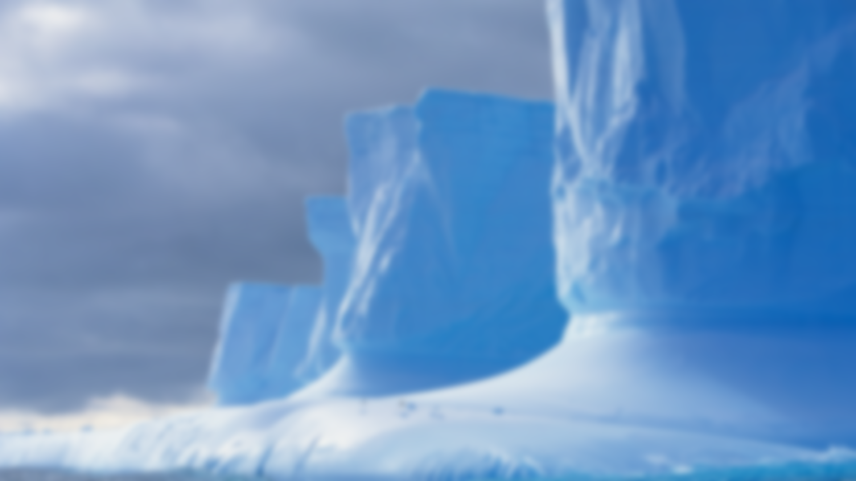

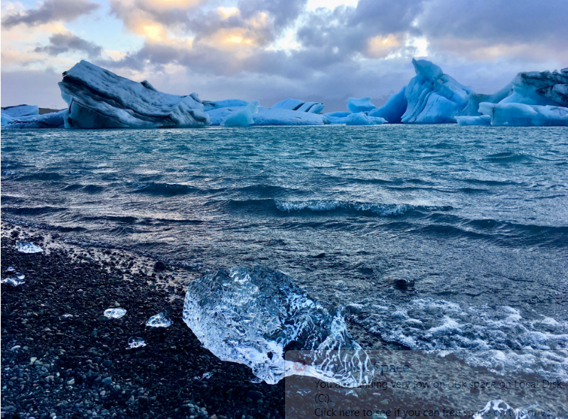
Three Situations
Icebergs in open water :
Icebergs will show bright spots against a dark background in optical images, higher wind reduces the contrast between open water and icebergs.
Icebergs in drifting ice :
Icebergs will create tracks in the drifting ice if there are larger floes of consolidated ice. Difficult to distinguish icebergs from a background in optical images if only backscatter information is available.
Icebergs in fast ice near calving areas :
Optical data shows shadows against the background, stationary ice means possible to identify icebergs over longer time periods.

Slide 6
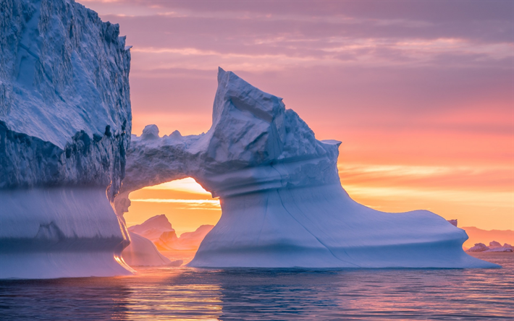

Automatic detection of icebergs in satellite images is regarded as a useful tool to provide information necessary for safety in Arctic shipping or operations over large ocean areas in order to prevent accidents.
The ice below the water is dangerous to ships. The sharp, hidden ice can easily tear a hole in the bottom of a ship. A particularly treacherous part of the North Atlantic has come to be known as Iceberg Alley because of the high number of icebergs that find their way there.

Slide 7
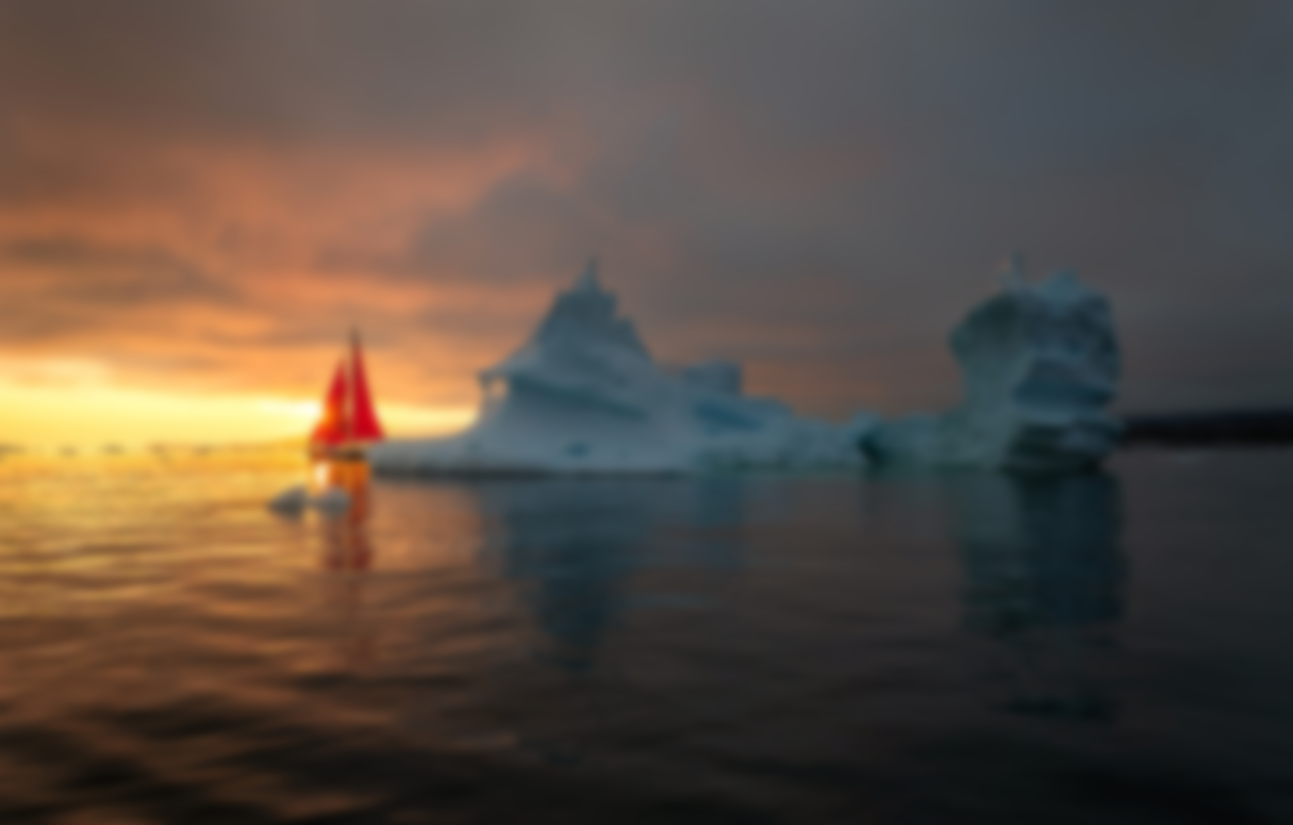


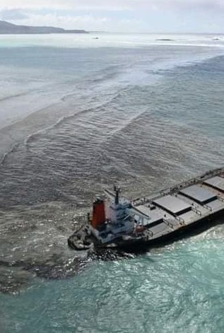
When oil accidentally spills into the ocean, it can cause big problems. Oil spills can harm sea creatures, ruin a day at the beach, and make seafood unsafe to eat.
Oil spills penetrate into the structure of the plumage of birds and the fur of mammals, reducing its insulating ability, and making them more vulnerable to temperature fluctuations and much less buoyant in the water.
Oil spills can have disastrous consequences for society, economically, environmentally, and socially.

Slide 8


Environment and tools used :
Scikit-learn.
Numpy.
Keras.
Pandas.
Matplotlib.
Model building through Jupyter notebook.
Using HTML,CSS and JavaScript for webpage.
Using Flask for integrating model and webpage in SPYDER environment.

Slide 9
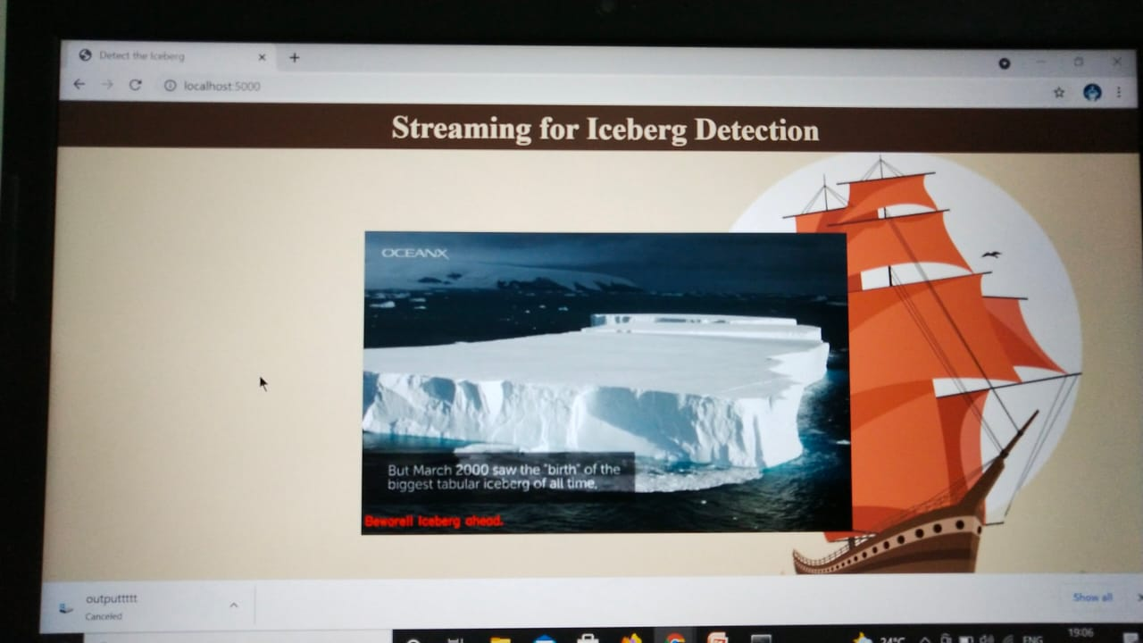
OUTPUT

Slide 10
CONCLUSION
This is one of the great examples where deep learning can be used to solve a challenging real world problem. If we are able to detect and segment icebergs in an image, it would be of great help to the logistics and transportation team in northern countries. It could bring a whole newdimension of transport for container ships and vessels by tracking icebergs from satellite images and videos in real-time. This implies that CNN can extract better features when presented with SAR images with different number of looks for the same target. The CNN is treated as a black box model, and additional experiments are necessary to understand how the change in image resolution affects the CNN internal activations. The use of additional procedures in the preprocessing step can potentially improve the classification results, and will be the focus of future work.

Slide 11

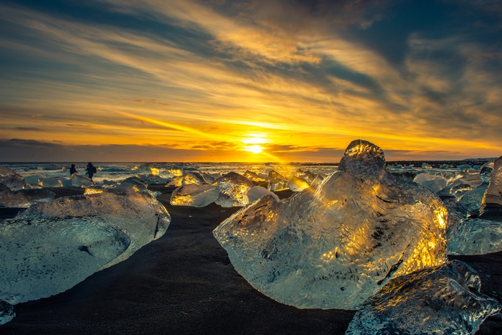
THANK
YOU

